Slide 1
DOI , ISSN etc

Slide 2

DOI
Digital Object Identifier
DOI of a document remains fixed over the lifetime of a document whereas the Metadata and URL may change.
Thus referring to an online document by its DOI provides more stable linking than simply referring to it by its URL.
DOI name differs from standard identifier registers such as the ISBN and ISRC . The purpose of an identifier registry is to manage a give collection of identifiers, whereas the primary purpose of the DOI system is to make a collection of indenter actionable and interoperable.

Slide 3
DOIs are in wide use mainly to identify academic, professional, and government information, such as journal articles, research reports and data sets, and official publications though they also have been used to identify other types of information resources, such as commercial videos.
Everytime a URL changes, the publisher has to update the metadata for the DOI to link to the new URL. It is the publisher's responsibility to update the DOI database.

Slide 4
DOIs should display on screens and in print in the format doi:10.1000/182
Prefix: Assigned by a DOI registration agency (e.g., 10.1000). It identifies the organization responsible for the content.Suffix: Assigned by the content publisher (e.g., abcd1234). It uniquely identifies the specific item.

Slide 5
DOI cont.
It may refer to a journal, an individual issue of a journal, or a single table in that article. The choice is left to the assigner but should comply with INDICES CONTENT MODEL
DOI resolver
http://doi.org
10.1364/AO.44.003784
10.10.16/S0030-4018(02)02362-3

Slide 6
ISSN
International Standard Serial Number
Identifies periodical publications like magazines
Components: 8-digit number with a hyphen

Slide 7
ISBN
International Standard Book Number
Prefix: Indicates the book's language or region (e.g., 978).Group Identifier: Identifies the country or language group (e.g., 3 for German-speaking countries).Publisher Identifier: Identifies the publisher (e.g., 16).Title Identifier: Identifies the specific book title (e.g., 148410).Check Digit: A single digit used to validate the ISBN (e.g., 0)
10 digit- Now 13 Digits
An e-book, a paperback and a hardcover edition of the same book would each have a different ISBN.

Slide 8
Indian Organization responsible for issuing ISSN
Indian Organization responsible for issuing ISBN
Raja Ram Mohan Roy Library Foundation , part of Ministry of Culture is responsible for registration of Indian publishers , authors , universities, institutions, and government departments that are responsible for publishing books..
Indian National Center for ISSN, NISCAIR, 14 Satsang Vihar Marg, New Delhi

Slide 9
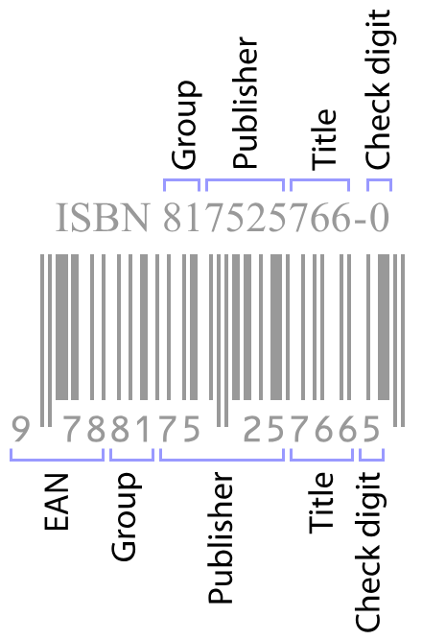

Slide 10
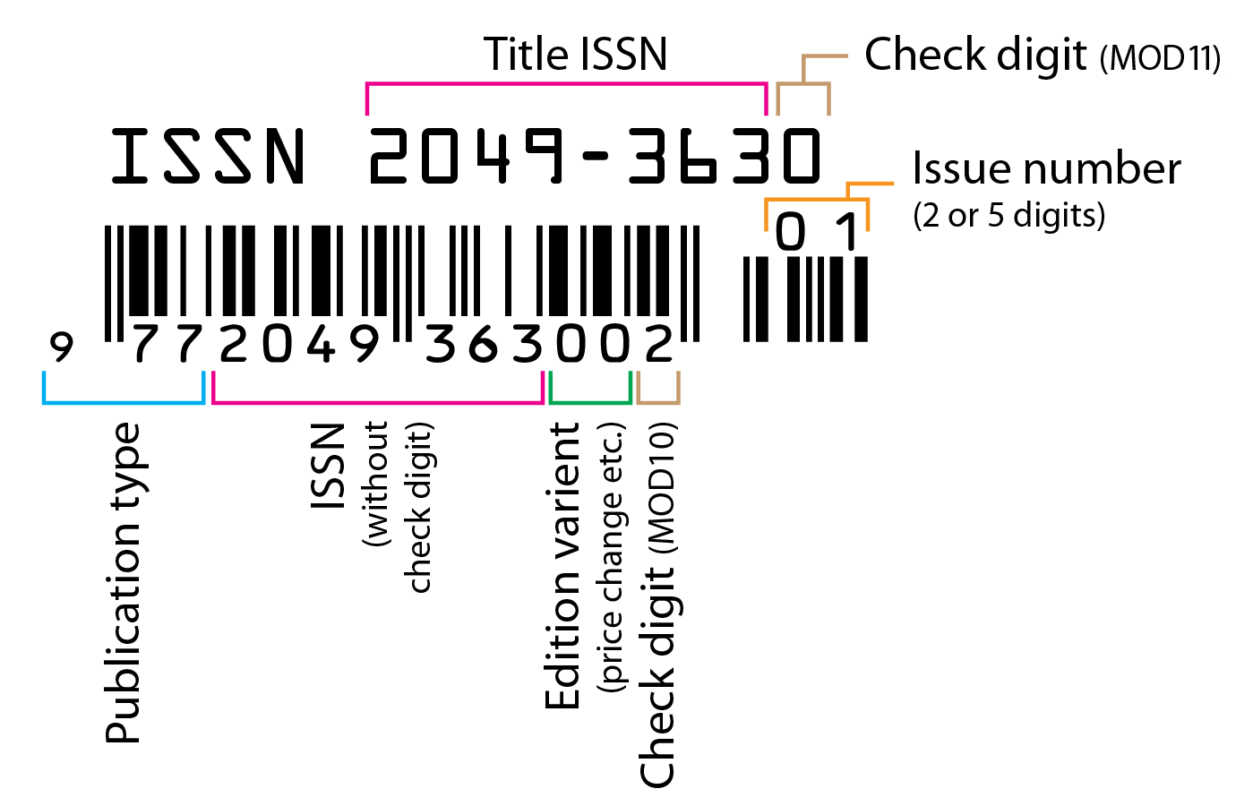

Slide 11

ISSN codes are assigned by a network of ISSN National Centres, usually located at national libraries and coordinated by the ISSN International Centre based in Paris. The International Centre is an intergovernmental organization created in 1974 through an agreement between UNESCO and the French government. The International Centre maintains a database of all ISSNs assigned worldwide

Slide 12
It is possible to obtain an ISSN before the publication of the first issue of a print serial or before the
release of a serial

